Slide 1
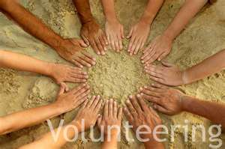

Slide 2
Volunteering is helping other people.

Slide 3
He is raising his hand.
He is volunteering to help with something.

Slide 4
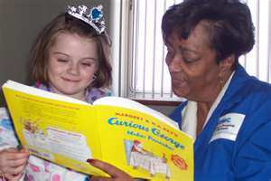
The woman is volunteering.
She is a tutor in the school.
She is helping the girl to read a book.

Slide 5
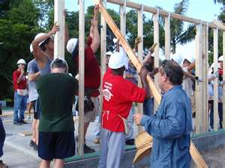
These people are helping to build a house. They are volunteers.

Slide 6
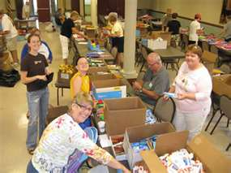
You receive no money for volunteering.

Slide 7
Why are people volunteering?
They like to help other people.
They want to help the community.

Slide 8
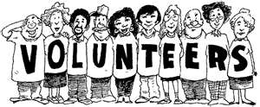
These are very special people!

